Slide 1
ONLINE EXAM SYSTEM
PROJECT BY:
SATHYAPRIYA
MONISHA SAMPATH
ASWATHA S
PREETHI VERONICA C

Slide 2
INTRODUCTION
Online Exam System is helpful for students, companies or any organization to conduct any examinations from this site.
Manually going through thousands of colleges and conducting interviews requires a lot of time, efforts and money, this is the reason that most of the companies prefer visiting only topmost colleges.
The students of low-grade colleges despite of having the caliber to compete are not getting enough exposure to job profiles of their choices and end up getting a low satisfying job.
To reduce this gap between these companies or any organization and such potential candidates this platform will help the deserving candidates to showcase their conceptual skills through an online exam, based on which, the companies can filter out candidates according to their needs.

Slide 3
OBJECTIVES
Online Examination System can reduce the hectic job of assessing the answers given by candidates manually.
Responses or the answers by the candidates can be checked automatically and instantly.
It will reduce paperwork to be an integrated Online Examination System.
The result can be shown immediately to the students reducing the anxiety.
Can create various reports and graphs for evaluation purpose almost instantly when and where required

Slide 4
MODULES
User Module
Admin Module

Slide 5
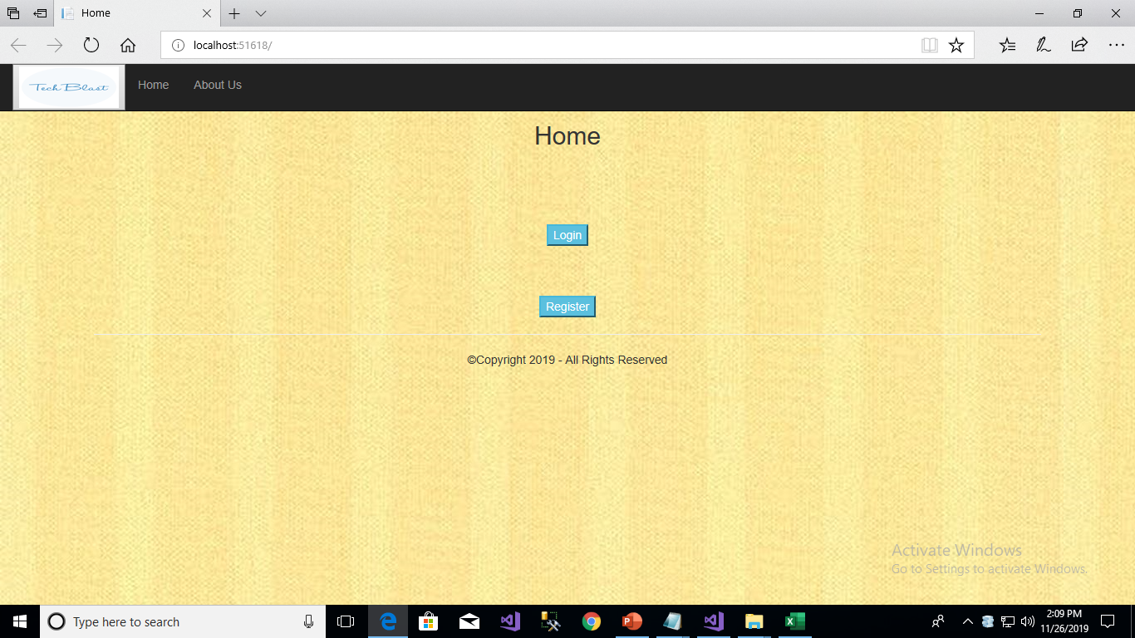
User module
n this module there will be a home page where the user will first have to login by entering ‘login id’ and ‘password’ to get access

Slide 6
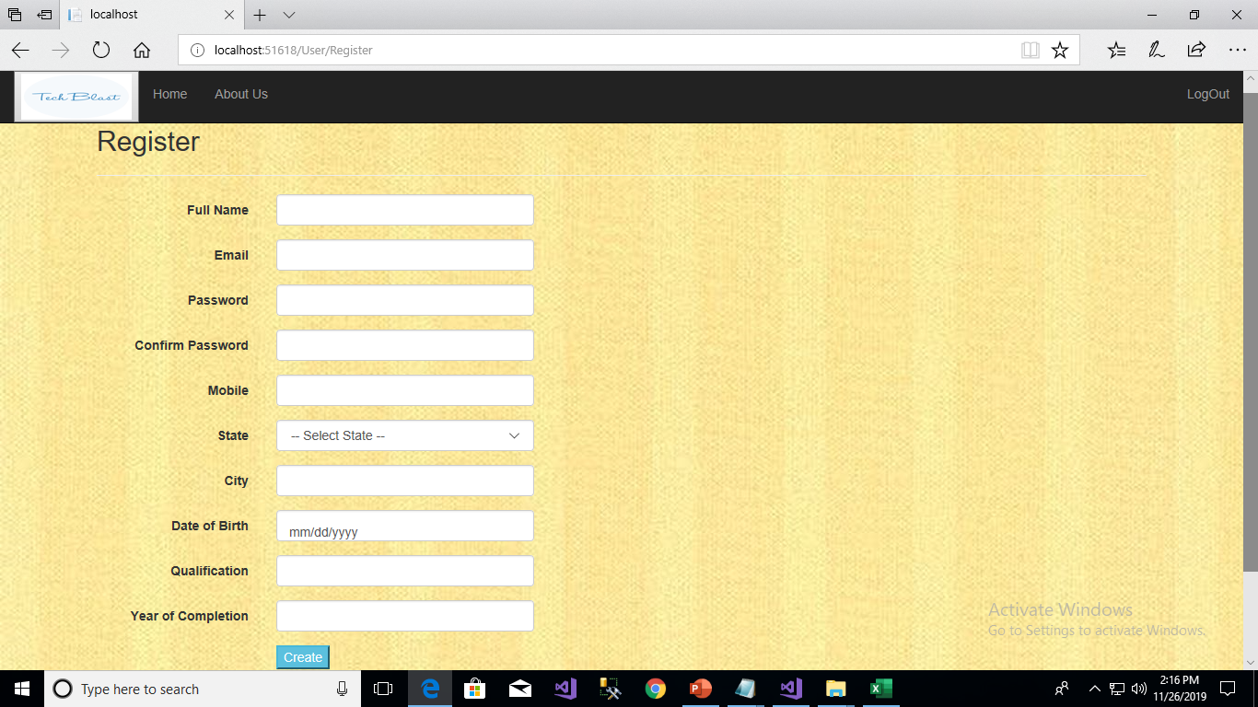
If the user is visiting for the first Time then he can register through the register page

Slide 7
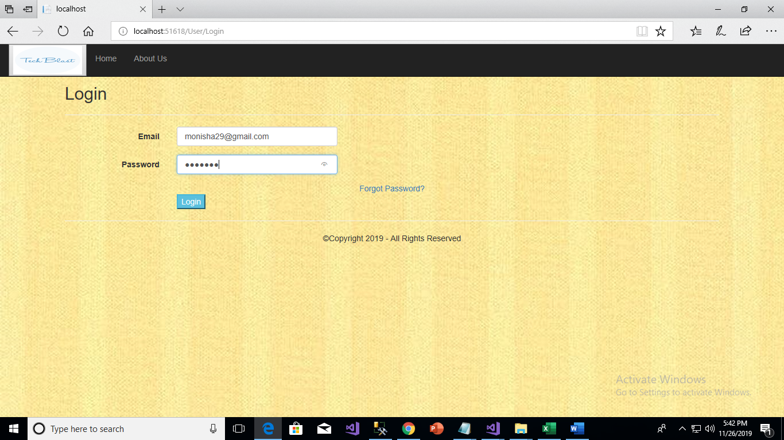
User and Admin can login through this Login page

Slide 8

After Login the user will be able to the ‘VIEW REPORT’ and ‘TAKE TEST’ .

Slide 9
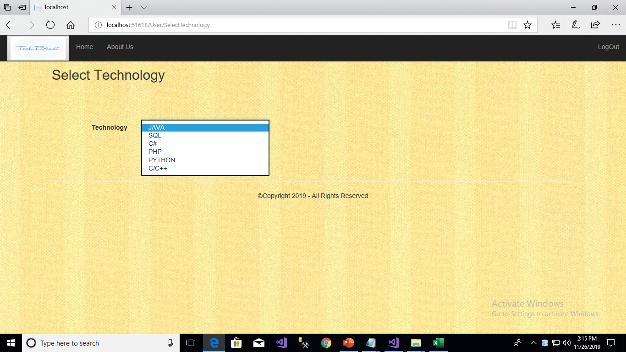
After choosing the take test option , user can choose the technology

Slide 10
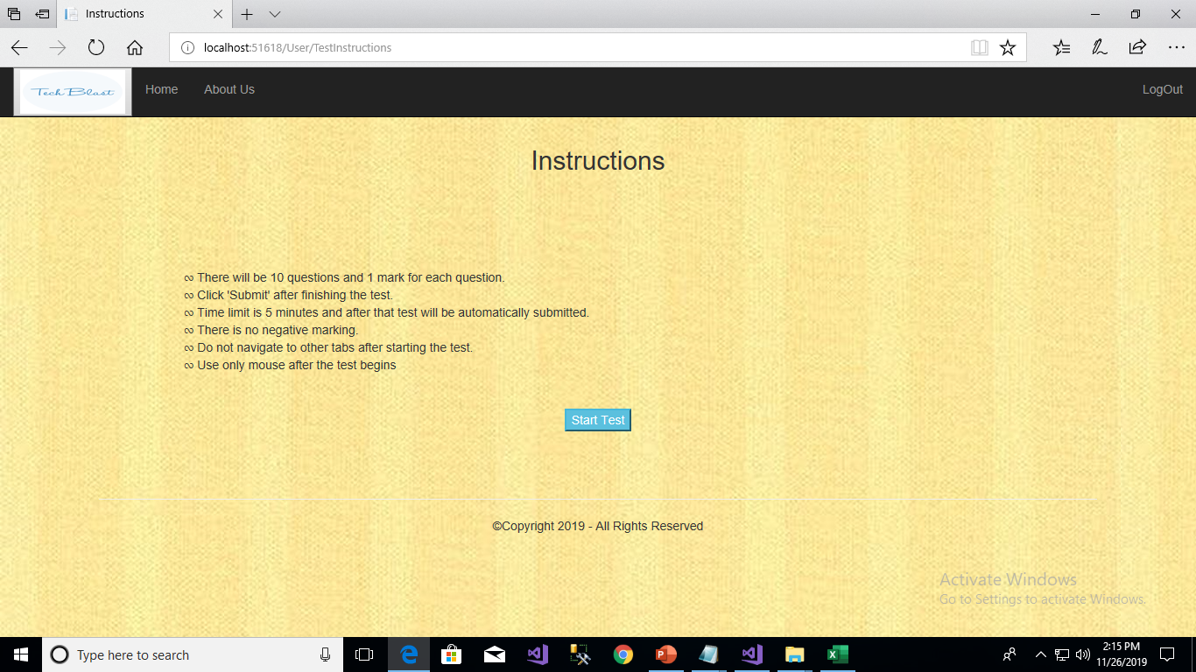
Then the User will be redirected to the Instructions page

Slide 11
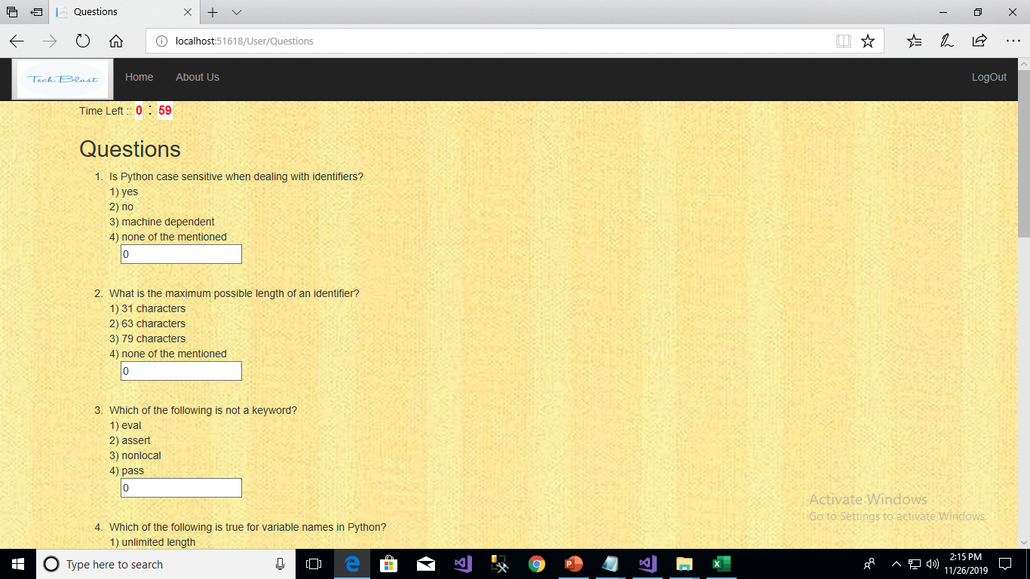
By clicking on the take test button at the instructions page then the user will be redirected to the test page

Slide 12
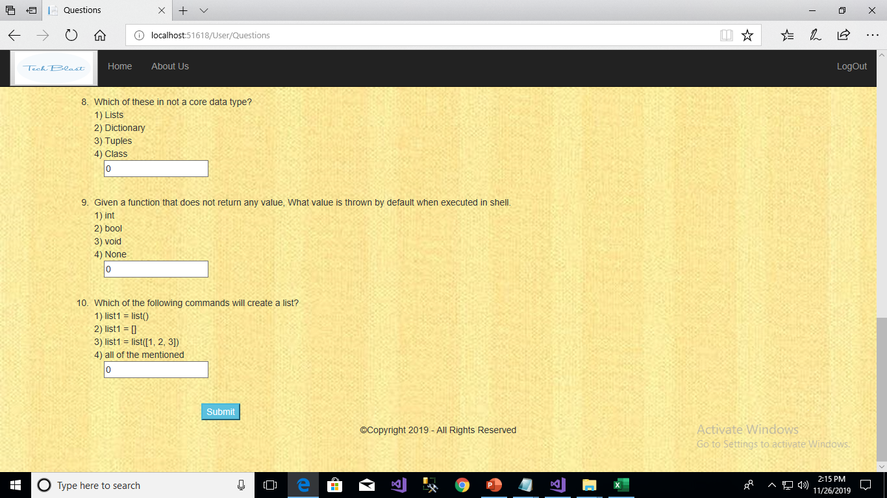

Slide 13
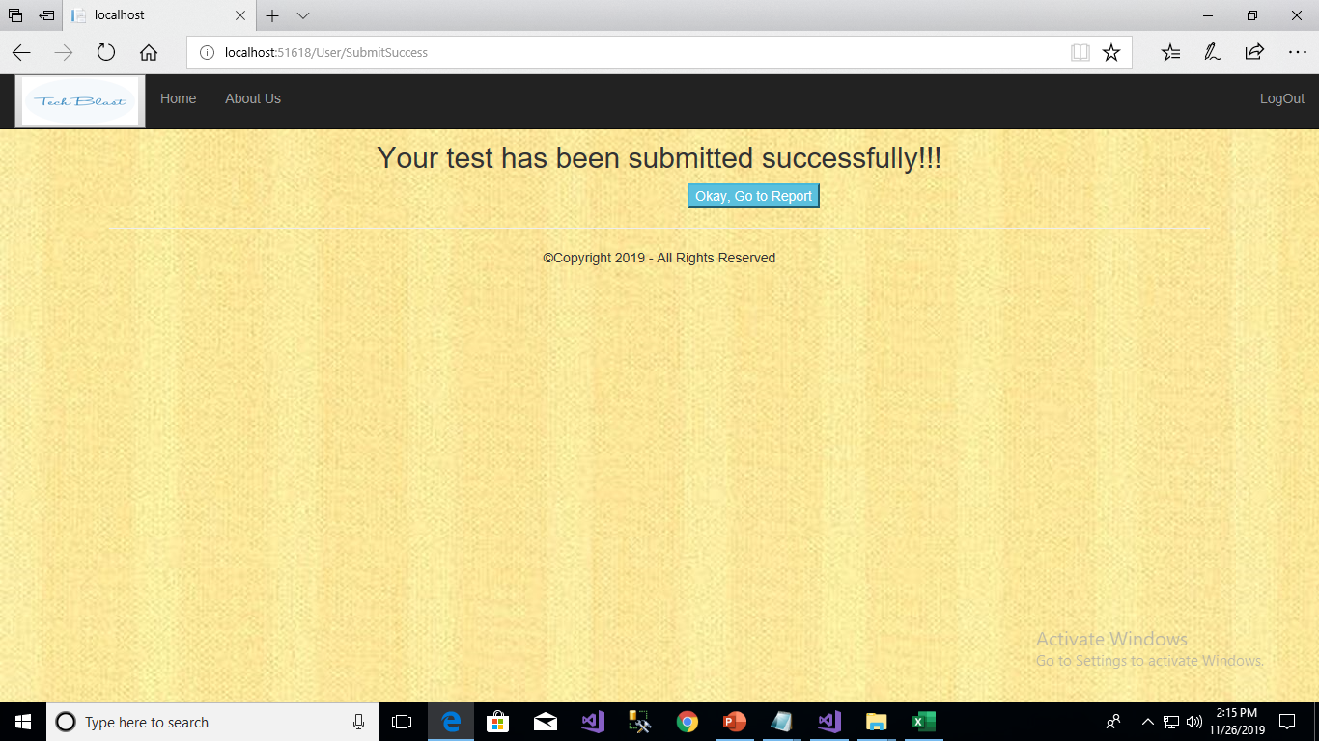

Slide 14
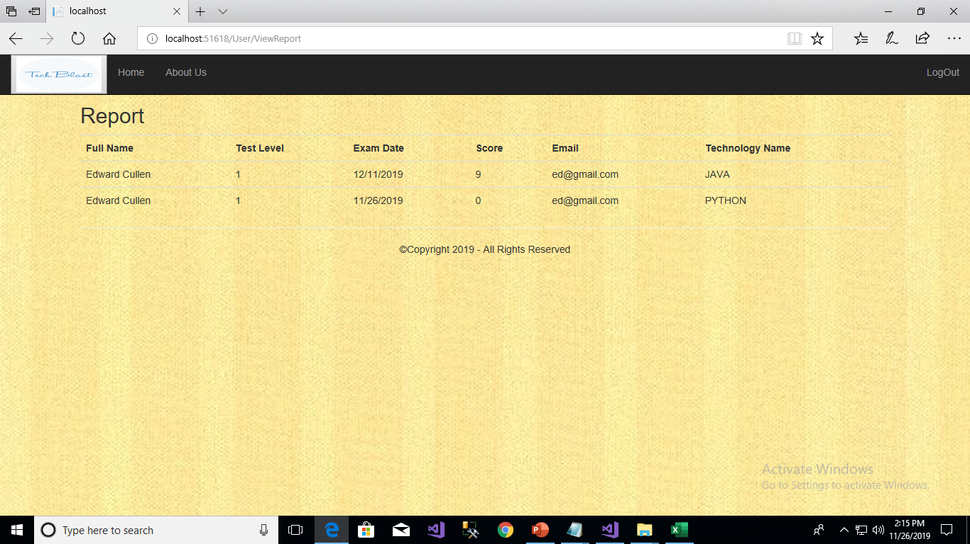
After Completing the test the user can view their Report

Slide 15
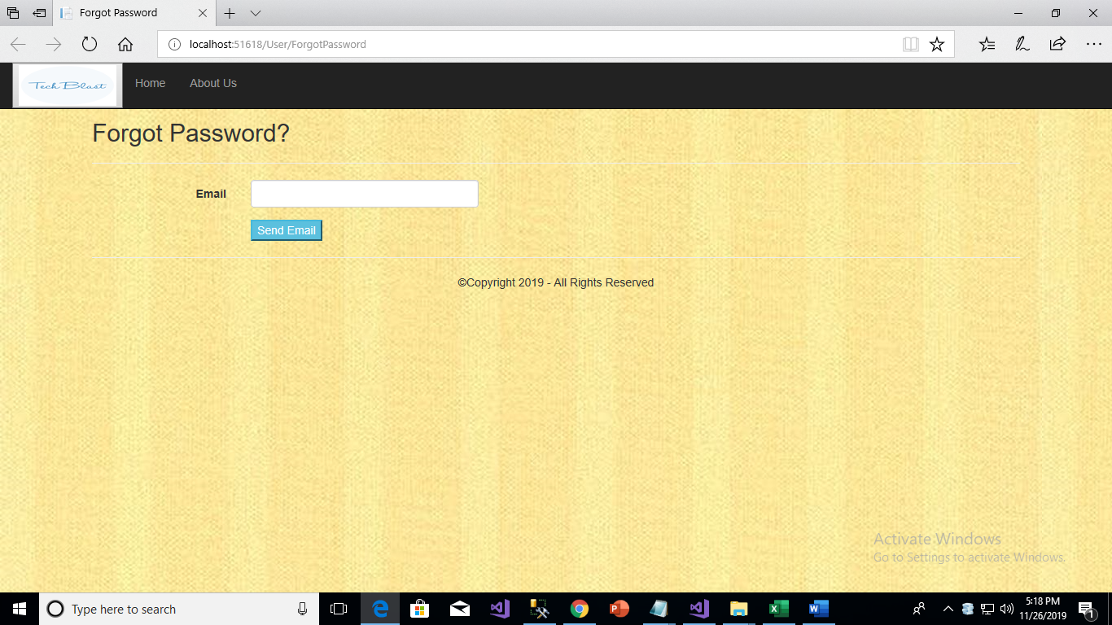
Forgot password

Slide 16
Admin module
In this module the admin will be able login by entering ‘login id’ and ‘password’. The ‘login id’ and ‘password’ will be inbuilt for admin.
The admin after logged in will be directed to a new page where the admin can click on the ‘VIEW REPORTS’ which on click will direct the admin to a new page where the admin will be able to enter necessary fields to fetch the students details according to the demand from the client. Also, after login the admin will be able to add question or remove question by clicking on ‘ ADD QUESTIONs ’ or ‘REMOVE QUESTIONS’

Slide 17
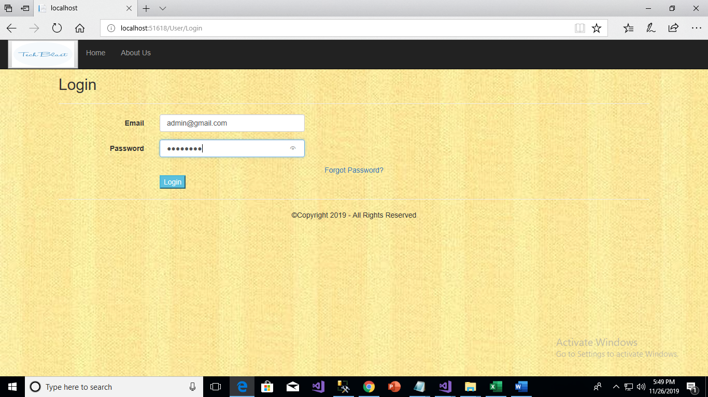
Here the admin will be able login by entering ‘login id’ and ‘password’. The ‘login id’ and ‘password’ will be inbuilt for admin

Slide 18


Slide 19
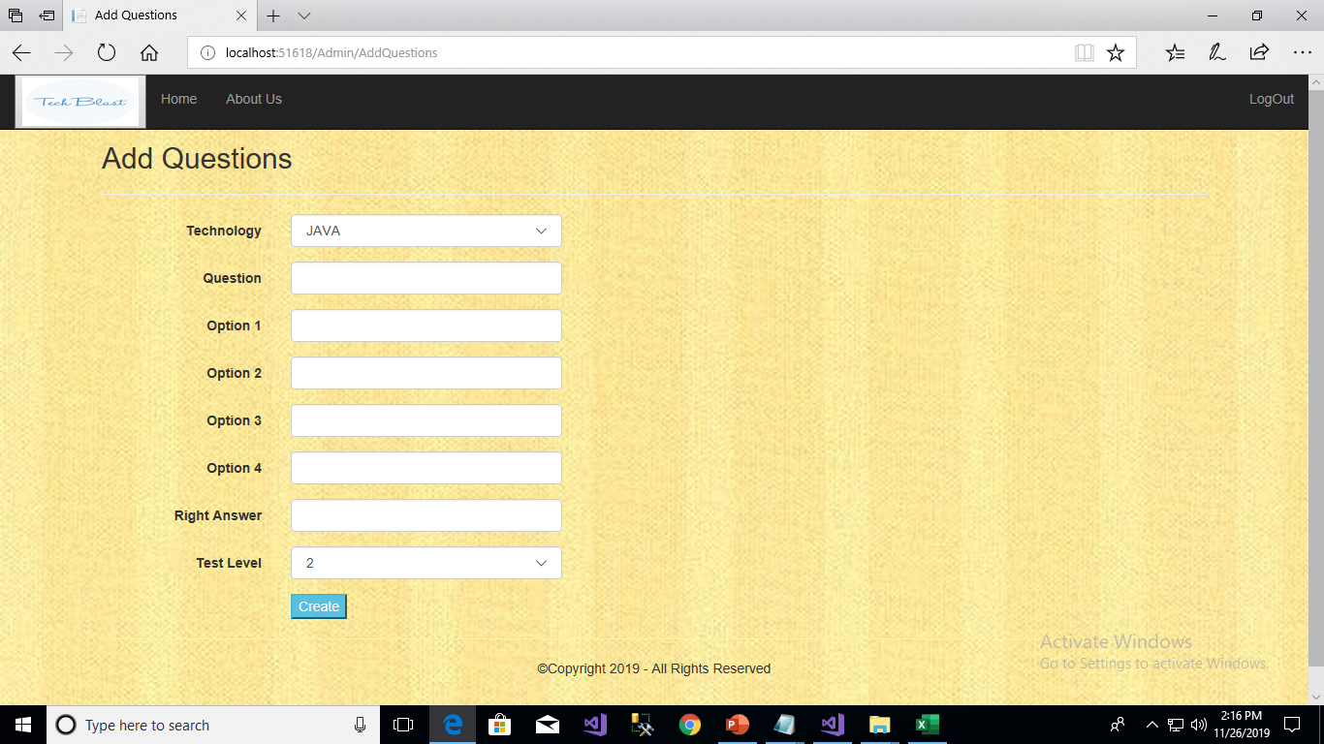
Add questions
Here the admin Can add questions

Slide 20
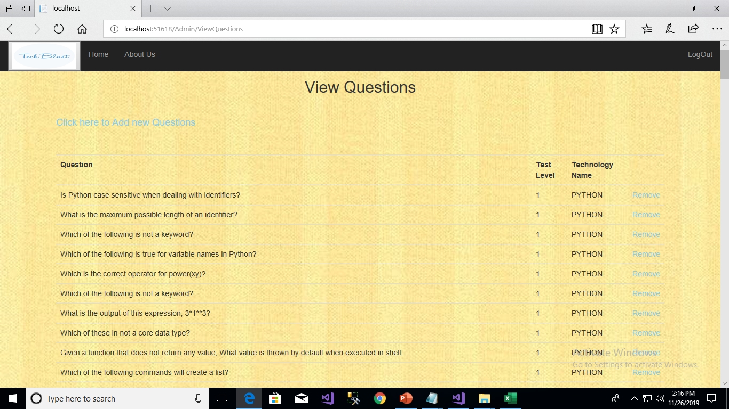
After adding the questions the admin can view the List of question, And to remove question the admin can view the question To choose which question to delete

Slide 21
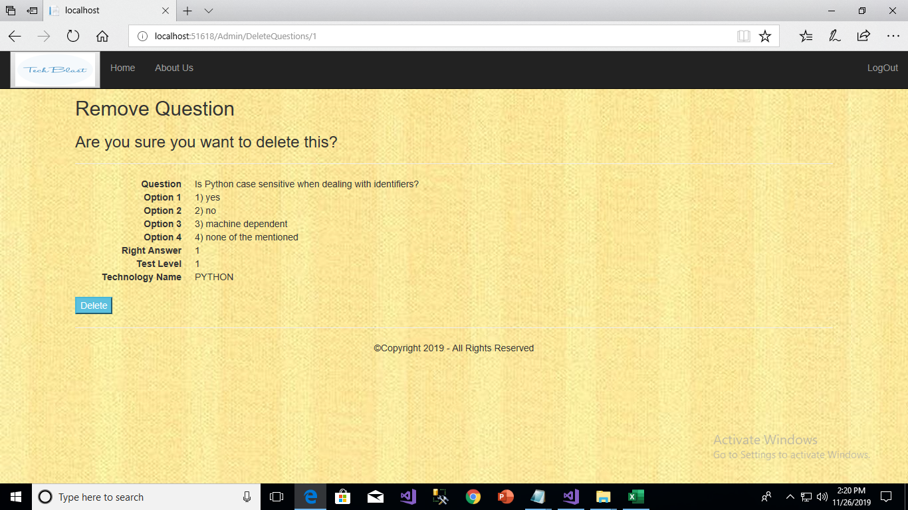

Slide 22
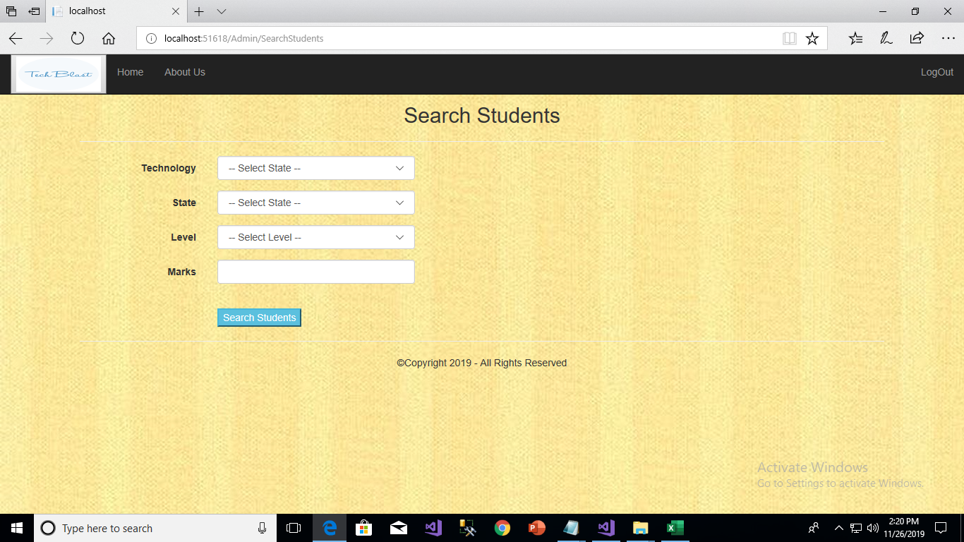
Search students

Slide 23
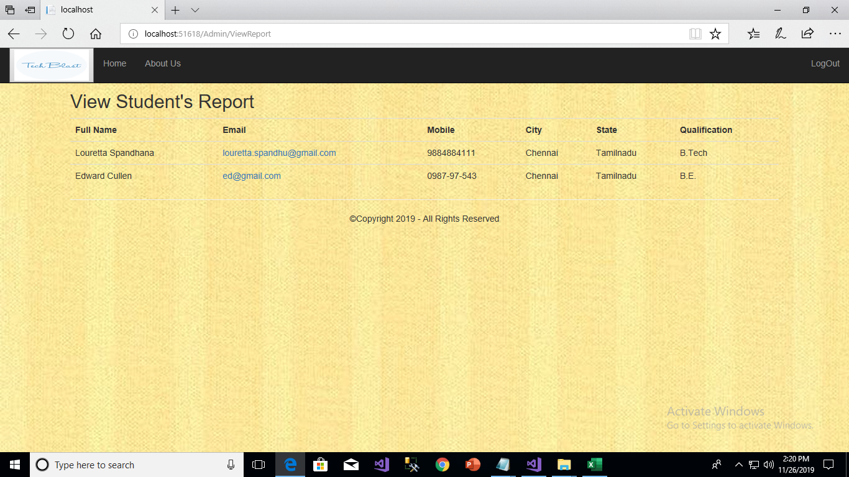
Admin can view the Report of students

Slide 24
Thank you !

